Slide 1

Fundamentals of Politics Research Lecture 6 (2020-21) Facts and values Dr Adrian Blau

Slide 2
Last time
Don’t be too trusting of methodological claims. Read widely, read sceptically.
Don’t be too trusting of empirical claims.
Good social science can be quantitative, qualitative, or mixed. So can bad social science!
Thinking probabilistically is vital.
✓
✓
✓
(empirical, normative)

Slide 3
This time
Can and should political science be value-free?
Examples of normative political science, and empirically sophisticated political theory.
Is political science conservative?
Intuitions, thought experiments, reflective equilibrium.

Slide 4
So what?
Pol theory often strongly empirical: Aristotle, Machiavelli, Federalist, Tocqueville, Marx.
But by mid-C20th, much political science was primarily descriptive and explanatory.
Gerring and Yesnowitz (2006, 109) want ‘a political science that is normatively oriented, empirical, and philosophically engaged’.
Irrelevance of much analysis of Duverger’s law (Gerring and Yesnowitz 2006, 104-5; Blau 2007).

Slide 5
‘Weber’
(From Hollis 1994, 208.)
Three phrases of research:
what goes in: value-relevance;
what happens: value-freedom;
what comes out: value-relevance.
Blau: normative ‘evaluation’ works in the same way. If–then.

Slide 6
Next steps
Run through several different examples (good and bad) of combining political theory and political science.
Examples: democracy.
(Not corruption, because of the essay.)

Slide 7
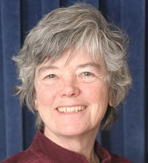
Jane Mansbridge (1980)
Philosophical analysis: unitary vs. adversary democracy.
Not as clear or as rigorous as much recent democratic theory.
[majoritarian vs. proportional]
Empirical analysis of New England town meeting and workplace democracy.
Not as rigorous as most recent political science.

Slide 8
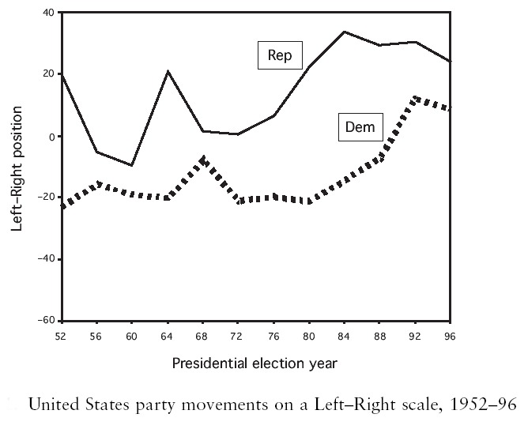
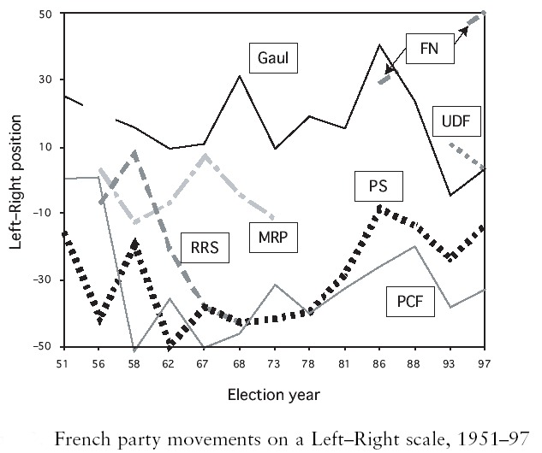
Budge and McDonald (2006)
Overstate their normative conclusions because they overlook the uncertainty/inaccuracy of their descriptive inferences.

Slide 9
Philippe van Parijs (1998)
Should we disfranchise elderly people?
Thoughtful normative analysis of the value of democracy (good in itself, or as a means to other ends).
Uses, but doesn’t do, empirical analysis.
Main weakness: doesn’t show that older voters do undermine intergenerational justice.

Slide 10
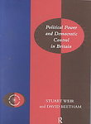
Weir and Beetham (1998)
Democracy ➔ political equality and popular control
➔ authorisation, accountability, responsiveness, representativeness
➔ 30 questions, e.g. ‘How far is there systematic opportunity for citizens to vote directly on basic constitutional changes?’
Attempt to answer those questions empirically.

Slide 11

David Beetham (2003)
When should Parliament take note of popular protests?
5 criteria.
Applies them to four protests, using his own empirical analysis.

Slide 12
Daniel Bell (1999)
Confucian approach to justifying a more meritocratic than democratic political system, with a House of Lords/House of Scholars.
The normative claim depends significantly on empirical evidence.
The empirical evidence is not too convincing.
(For a quick critique, see Blau forthcoming, 9-10.)

Slide 13
Pol science and pol theory?
Some of this is closer to ‘political science’, some is closer to ‘political theory’.
As ever: we all fall short of the ideal – here, two ideals, and also their combination!
Political science usually has some normative content.
Political theory almost always involves some empirical claims.

Slide 14
Is political science conservative?
Gerring (2012, 71): ‘No one – or virtually no one – argues against the virtues of peace, prosperity, democracy, and self-fulﬁllment.’
Beware the naturalistic (is ➔ ought) fallacy.
‘a moral and political “de-skilling” of the electorate’ (Offe and Preuss 1991, 165).
Many experiments are done on (US) college students – results often vary elsewhere. See Henrich et al. (2010) on ‘WEIRD’ countries.

Slide 15

Thought experiments in pol. theory
Can rely on intuitions (which can be misleading: Tversky & Kahneman 1981, Sunstein 2005).
Example: is killing worse than letting die?
Scenario 1: I push a child under water in a bathtub, thereby killing him, to collect his inheritance.
Scenario 2: A child slips in a bathtub. I could easily lift him out but do not because I want to collect his inheritance.
Most Similar Systems Design
FrancesKamm (1993, 18-19)

Slide 16

Exercise 1
‘A terrorist has planted a nuclear bomb in a city in your country. It will go off in one hour’s time, and the city can’t be fully evacuated in time. A million people will die if the bomb is not disarmed. The bomb can’t be disarmed without a code, and only the terrorist knows the code to disarm the bomb. You have captured the terrorist, but the terrorist will not reveal the code unless tortured. Does this justify torture?’
How would you change this thought experiment to get a better understanding of when, if ever, torture might be justified? Hint: focus on the variables.

Slide 17
X-Phi (experimental philosophy)
Haidt (2008, on edge.org): Democrats and Republicans see the world/politics differently.
Haidt et al. (1993, 613): ‘cultural norms and culturally shaped emotions have a substantial impact on … the process of moral judgement’.
Greene (2013): emotion/System 1/thinking fast, vs. reason/System 2/thinking slow.
Gray (2012, 2014), Nagel (2013): but Greene and Haidt defend utilitarianism ….

Slide 18
Reflective equilibrium
Based on Rawls (1971).
Try to achieve coherence between normative judgements, especially between intuitions, principles and evidence.
Don’t be governed by intuitions, and don’t ignore them.
Ditto for principles.
Ditto for evidence.

Slide 19
Approaching reflec. equil.
You can approach reflective equilibrium with a ‘dialectical’ approach when you do political theory.
Think against yourself, like a social scientist.
Use examples (real or hypothetical), principles, arguments etc. to think through a normative position.

Slide 20
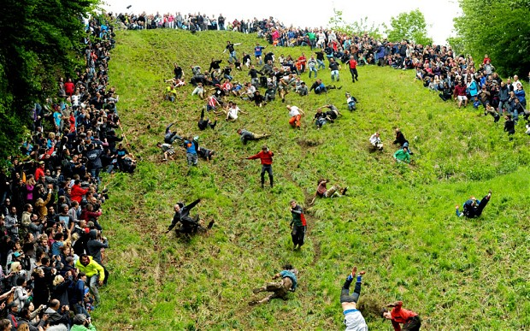
Example

Slide 21
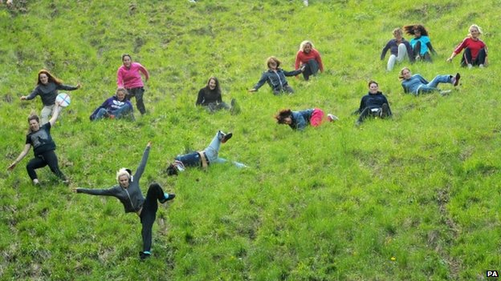

Slide 22
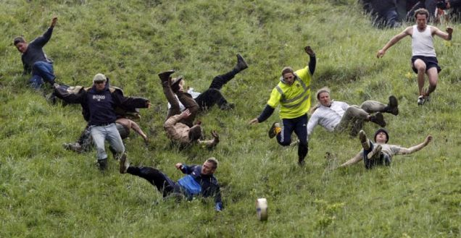

Slide 23
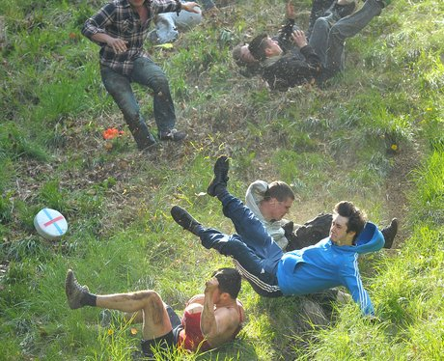

Slide 24


Slide 25
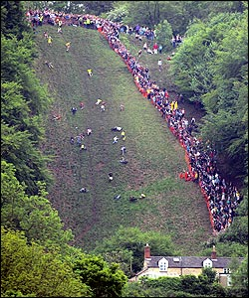

Slide 26
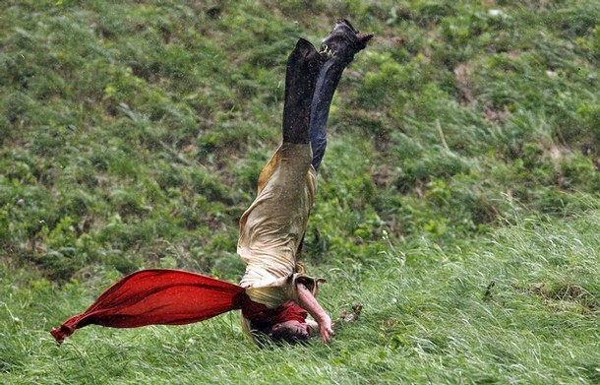

Slide 27
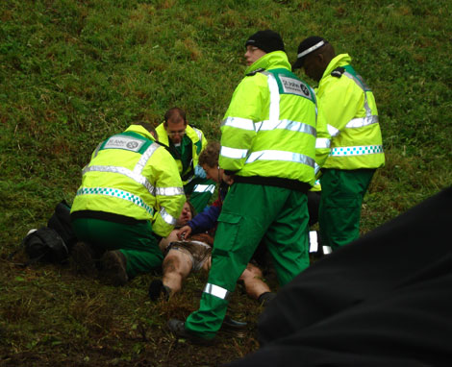

Slide 28
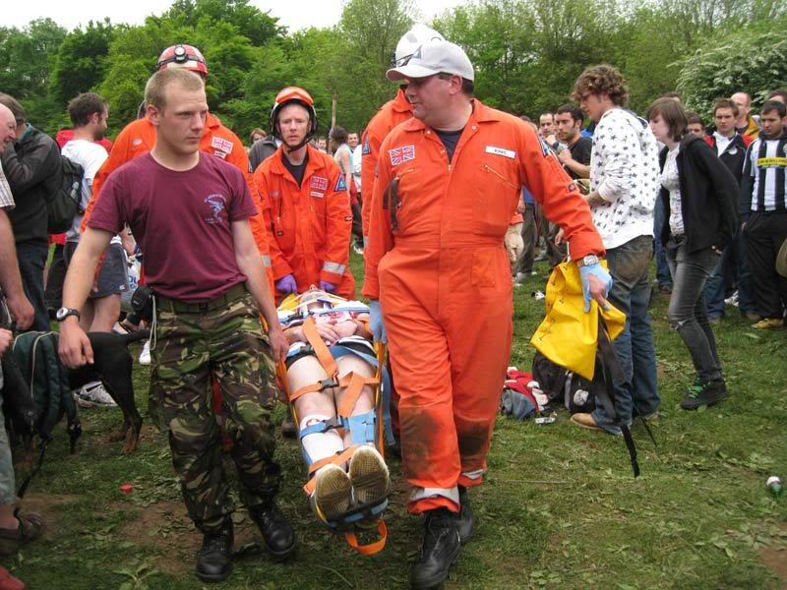

Slide 29


Slide 30
Reflective eq. about cheese-rolling
Do what you want as long as you don’t harm others.
Does it harm others if the NHS treats your injury?
Can we require participants to go private?
Might the numbers involved affect our decision? How about the drunkenness of participants?
Restrictions to hinder self-harm?
Analogy with banning highly addictive substances?
Etc. Think against yourself, repeatedly.

Slide 31
Exercise 2
Show how a political theorist can use reflective equilibrium to investigate whether pornography should be banned.
What counts as ‘pornography’?
Hardcore pornography; consenting adults.
Objectifies women/partners. But can we restrict all things which objectify women/partners?
Practicality: is ➔ ought???

Slide 32
Conclusions
Political scientists can and often should be normative, but should try to be impartial.
Those who cross the artificial divide between political science/theory should try to use sophisticated normative and empirical ideas.
We should be aware of the conservatism of political science, and cautious about intuitions.
Reflective equilibrium is important.

Slide 33
References
Beetham, David, 2003. Political participation, mass protest and representative democracy, Parliamentary Affairs 56:4, 597-609.
Beetham, David, Iain Byrne, Pauline Ngan, and Stuart Weir, 2002. Democracy Under Blair: A Democratic Audit of the United Kingdom. London: Politico’s Publishing.
Bell, Daniel, 1999. Democratic deliberation: the problem of implementation, in Stephen Macedo, ed., Deliberative Politics: Essays on Democracy and Disagreement. Oxford: Oxford University Press, 70-87.
Blau, Adrian, 2007. Book review, Party Politics 13:6, 761-3.
Blau, Adrian, forthcoming. ‘How (not) to use history of political thought for contemporary purposes’, American Journal of Political Science. Link.
Budge and McDowell (2006) – see last week’s Powerpoint references.
Gerring (2012) – see last week’s Powerpoint references.

Slide 34
References
Henrich, Joseph, Steven Heine, and Ara Norenzayan, 2010. The weirdest people in the world?, Behavioral and Brain Sciences 33:2-3, 61-83.
Kamm, Frances, 1996. Morality, Mortality. Volume II: Rights, Duties, and Status. Oxford: Oxford University Press.
Mansbridge, Jane, 1980. Beyond Adversary Democracy. New York: Basic Books.
Offe, Claus, and Ulrich Preuss, 1991. Democratic institutions and moral resources, in David Held, ed., Political Theory Today. Cambridge: Polity, 143-71.
Tversky, Amos, and Daniel Kahneman, 1981. The framing of decisions and the psychology of choice, Science vol. 211 no. 4481, 453-8.
van Parijs, Philippe, 1998. The disfranchisement of the elderly, and other attempts to secure intergenerational justice, Philosophy and Public Affairs 27:4, 292-333.

